Slide 1
Automatic true-false question answering in meetings
Master thesis defense presentation
Namur, 25 juin 2009
Le Quoc Anh
University of Namur (FUNDP)
Committee:
Prof. Dr. Naji Habra (Chair)
Prof. Dr. Jean-Paul Leclercq
Dr. Andrei Popescu-Belis
Ravi Ramdoyal
Notes:
20 minutes => respect du temps => entre 10 et 15 slides
Demander de mettre en évidence les points saillants de votre travail, du point de vue des:
Objectifs
De la méthodologie
Des résultats
Des prolongements possibles
Il est bien entendu qu’en 20 minutes d’exposé, il vous est impossible d’entrer dans les détails: les questions du Jury qui suivront la présentation viseront à obtenir des éclaircissements éventuels sur le texte de votre mémoire ainsi que sur les sujet qui y sont développés.

Slide 2
Outline
Objectives
Methodology
  Algorithm
  Database
  Evaluation methods
Results
Conclusion

Slide 3
Objectives
Make an attempt at building an automatic meeting browser following a question-answer (QA) approach.
  Develop an algorithm that determines the true and the false statements about facts on meetings.
  Compare with humans using existing meeting browsers

Slide 4
Approach
Orientation of algorithm:
  Lexical similarity
  N-gram matching
  Vocabulary extensions
Data to test:
  Two meeting transcripts from AMI Meeting Corpus
  About 200 BET questions

Slide 5
The BET Questions
A set of the pairs of true-false statements were created using a well-defined methodology to capture facts related to a meeting for the Browser Evaluation Test method.
The BET is a procedure to use these “questions” for evaluating a browser’s capacity to help users to answer them.

Slide 6
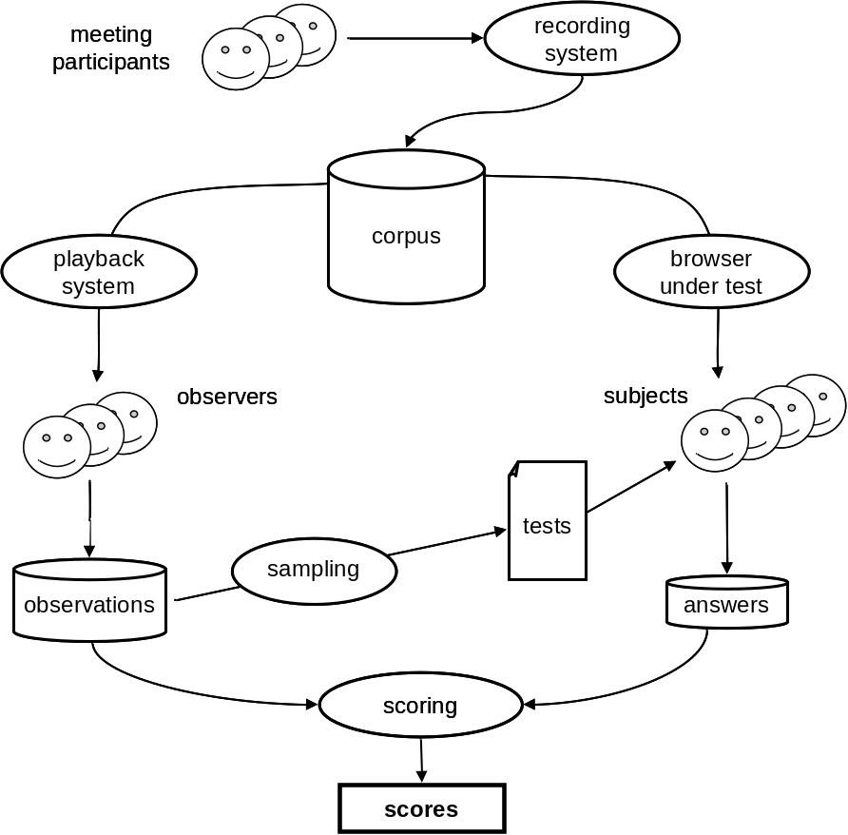
The BET Method

Slide 7
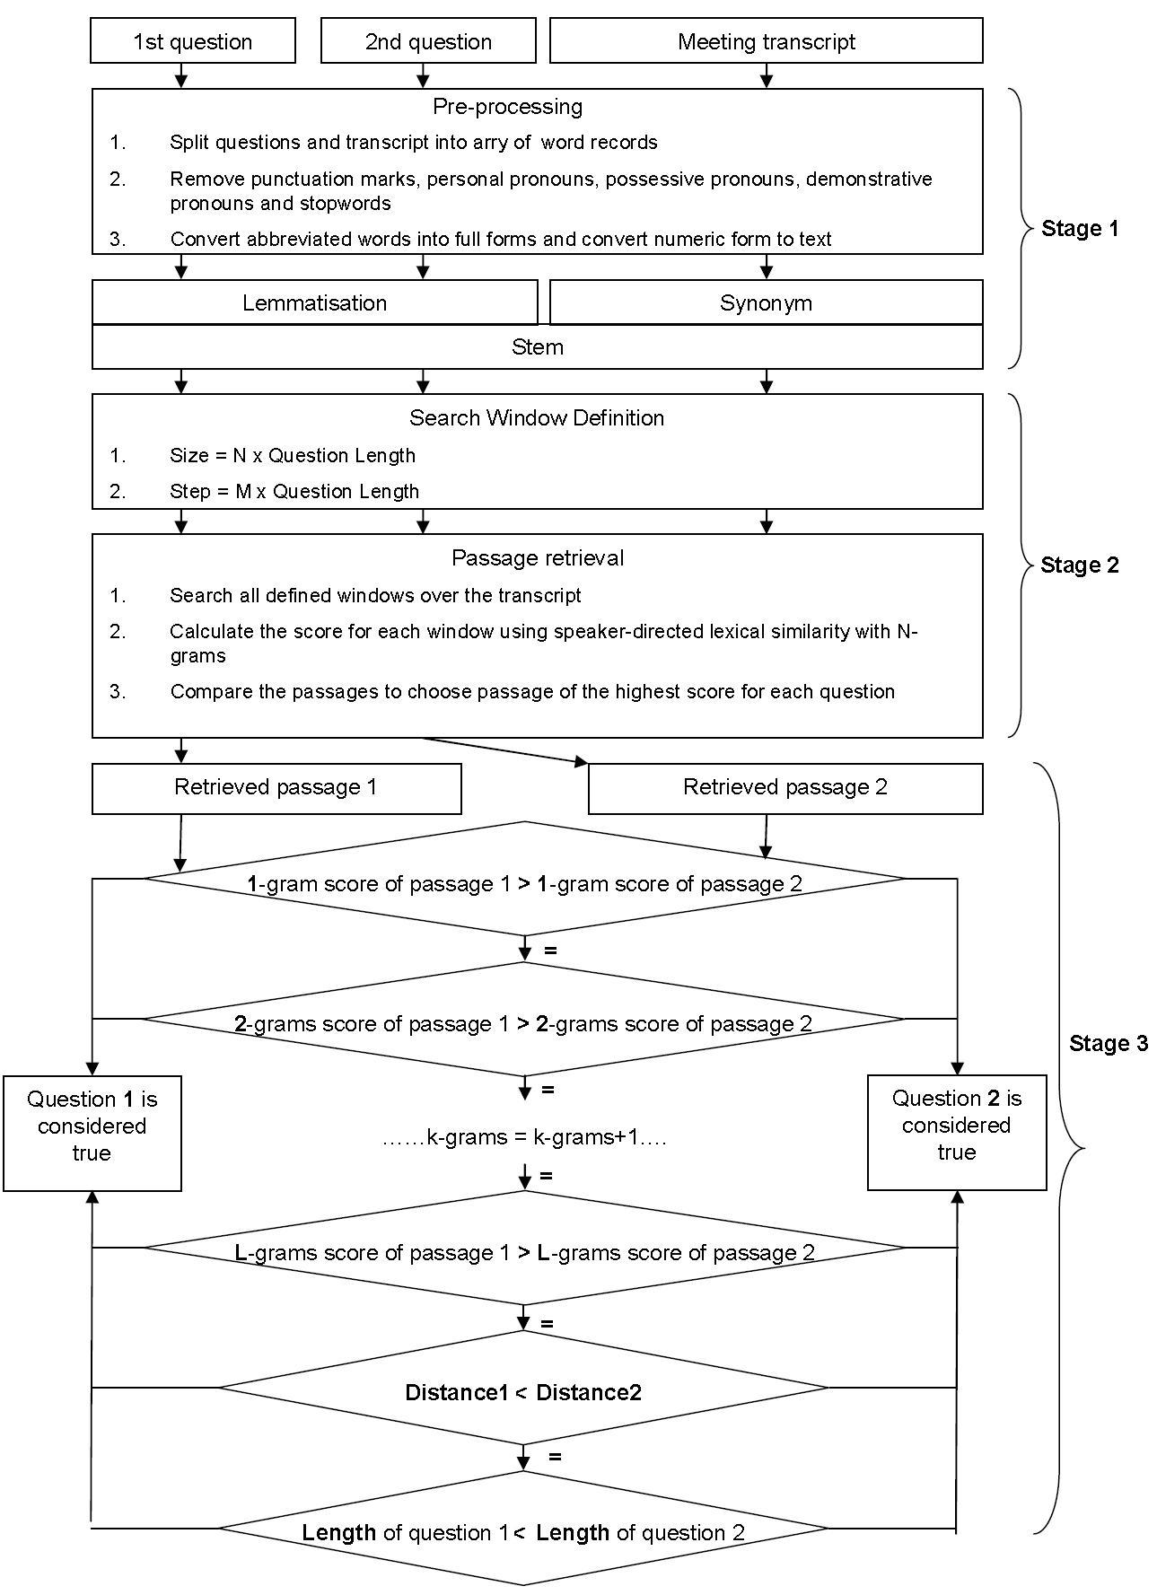
Algorithm: Overview

Slide 8
Algorithm: Pre-processing
Objective:
  Standardize the input data
  Enhance the performance of the algorithm
Method:
  Transform questions and transcript into an uniform data
    Remove stop-words and punctuation signs
    Convert numeric form and abbreviated form into full text form
  Enhance the probability of matching between a question word and a transcript word by adding:
    Stem
    Lemma
    Synonyms

Slide 9
Algorithm: Passage Retrieval
Objective:
  Find a passage from the transcript that is the most likely to contain information about the answer.
Method:
  Choose a passage of the highest score.
  The score of a passage is sum of all the score of matched words between the passage and the question.
  The score of a matching word is calculated as follows:
    If the matched word is a speaker’s name, it has the highest score (e.g. 4.0)
    If it is spoken by a speaker mentioned in the question, it has the second highest score (e.g. 2.5)
    Otherwise, it has a “normal” score (e.g. 1.0)
    If it belongs to the set of synonyms, it has “low” score (e.g. 0.5)
  Recalculate passage scoring using matched substrings of i-words instead of matched words in the case that more than one passage have the same highest score (i=2,3,...max = number of question words) .

Slide 10
Algorithm: True-False Answer
Objective:
  Determine the true statement in a pair based on two retrieved passages.
Method:
  The true statement is the one whose passage has a higher score.
  If two passage scorings are equal, the passages scorings from calculating bigrams of words are compared and so on.

Slide 11
Evaluation Method
Compare a result obtained by the system with a reference result obtained by hand to assess its correctness.
Use the Cross-Validation method to calculate the average of results.

Slide 12
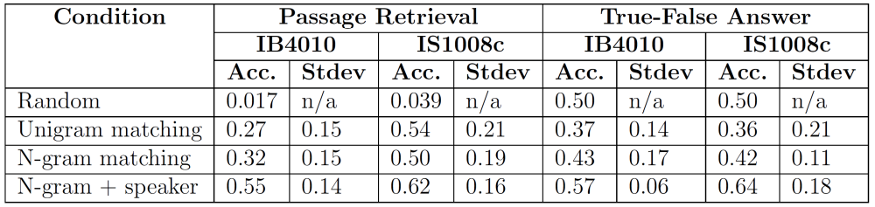
Results on manual transcripts
Passage retrieval provide excellent results compared with the chances of randomly locating the correct passage.
The algorithm needs improvement for the True-False Answer stage.

Slide 13
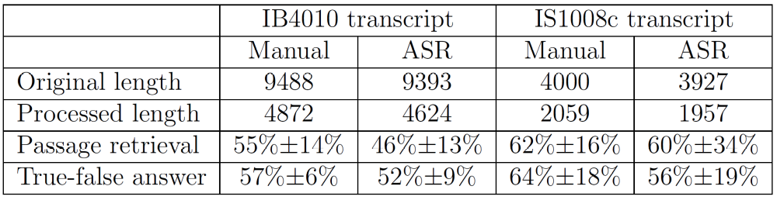
Results on ASR transcripts
The scores decrease with respect to the manual transcript, but remain in a similar rang.
The system is robust with respect to the quality of the ASR.

Slide 14
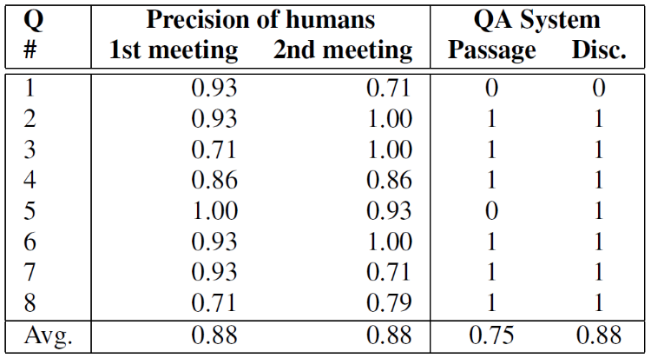
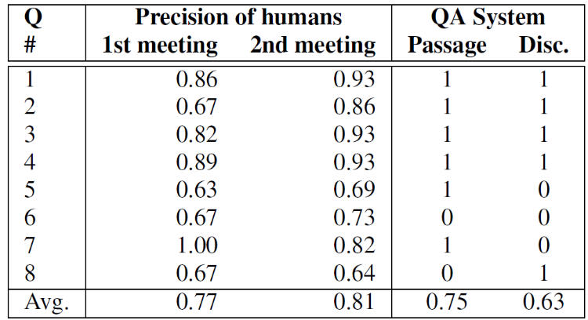
Compare with human subjects
Table 1: IB4010 meeting
Table 2: IS1008c meeting
  Compare the results obtained by the system with these obtained by human subject using TQB browser (Transcript-based Query and Browsing Interface).
  It seems that human subjects and the system have the same some difficulties (#1 in table 1, #5 and #6 in table 2) .

Slide 15
Results on ASR Summaries
Table 1: IB4010 meeting
Table 2: IS1008c meeting
In this case, the random summaries seem better.
This approach could provide an indirect measure of the quality of a a summary (the higher the quality, the lower the degradation when shorter and shorter summaries are used).

Slide 16
Conclusion
The results obtained by the system is quite below that obtained by humans using existing browsers.
The Passage Retrieval stage gives good results compared to random results in a short time.
This system should be integrated with existing meeting browsers as an assistant tool to help humans answer questions by locating the relevant passage.

Slide 17
Future works
Integrate this system into existing meeting browsers.
Improve the passage retrieval by doing research on semantic text.
Develop a module to extract a concise answer after retrieving the passage instead of giving true-false answers.

Slide 18
Thanks for your attention!

